Slide 1
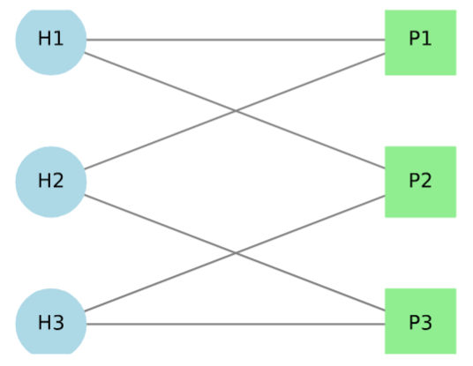
Memory Allocation With Octopus
Problem formulation: A host connects to MHD M1, M2, …, Mk. When a VM lands on this host, it needs to allocation X GB CXL memory from these MHDs.
The memory allocation algorithm should decide how much memory to allocate from each of these MHDs.
Allocate from P1
New VM
Allocate from P2

Slide 2
Memory Allocation With Octopus
Allocation algorithms can consider different goals:
Utilization: Allocate from the least utilized MHDs can balance the usage of each MHD.
Fully-connected topology achieves the best utilization
Bandwidth: Allocate evenly from MHDs enables page-level interleaving to achieve higher memory bandwidth
Focus on utilization in the following analyses

Slide 3
Simulation Settings
Azure VM traces:
VMs: node, allocation time, deallocation time, memory size
Node: memory capacity
Randomly group node into Octopus pods
Only nodes with the same machine type can be in the same pod
Use traces from multiple clusters
Same traces used in Coach (ASPLOS ‘25)
Output: Minimum MHD capacity without violating VM scheduling decisions
Assume that all MHDs within the same pod have the same capacity

Slide 4
Greedy Allocation Algorithm
Allocate from the least utilized MHD
Split the allocation if necessary
Do not migrate allocated CXL memory between MHDs
New VM
(10 GB CXL)
Allocate 7.5 GB from P1
Usage: 0 GB → 7.5 GB
Allocate 2.5 GB from P2
Usage 5 GB → 7.5 GB

Slide 5
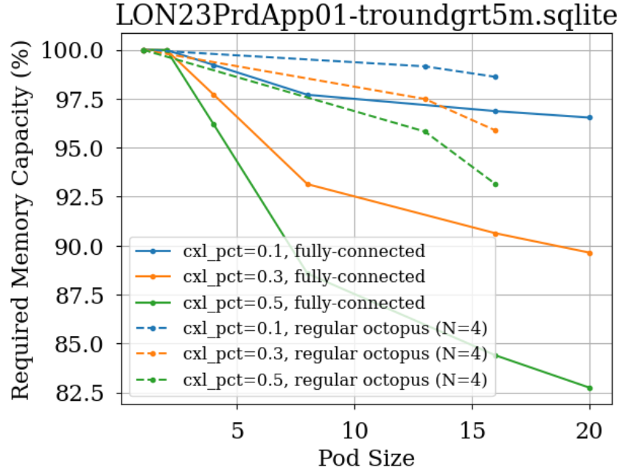
Fully-Connected vs. Octopus (Greedy)

Slide 6
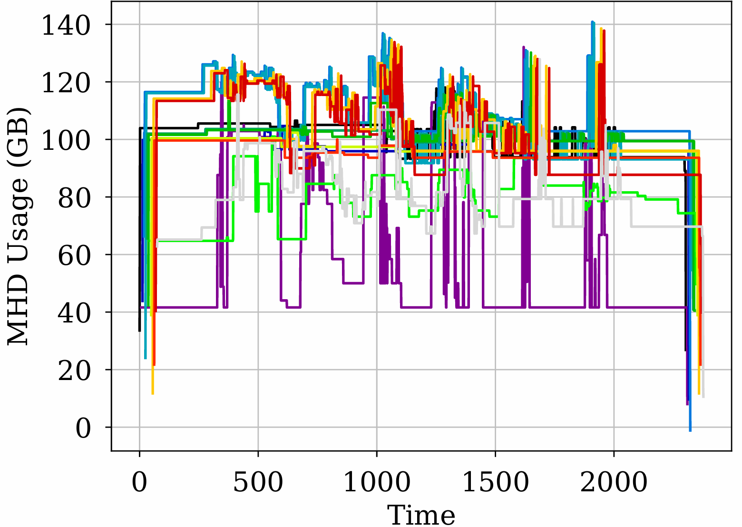
MHD Usages With Octopus (Greedy)
Max peak: 142 GB
Min peak: 103 GB

Slide 7
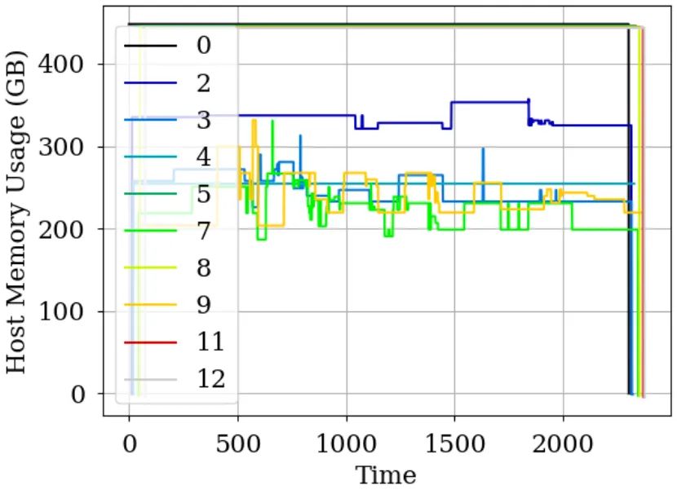
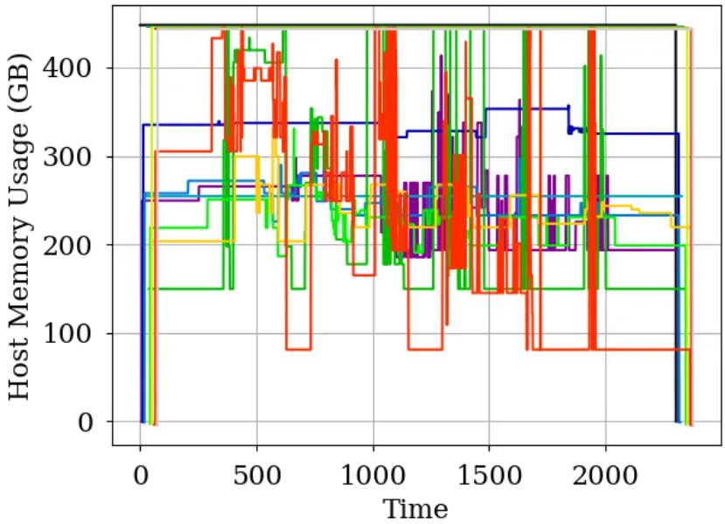
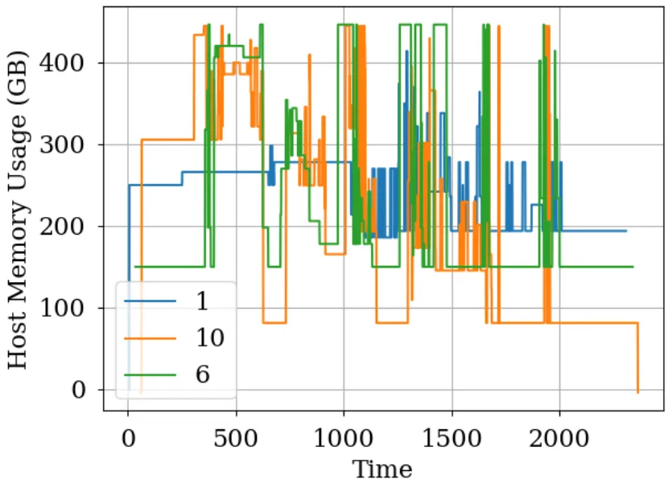
MHD Usages With Octopus (Greedy)

Slide 8
Optimal Allocation Algorithm
Dynamically migrate memory between MHDs to minimize the max usage among all MHDs
Upper bound for any allocation algorithms in terms of memory savings
Host 1: A GB CXL
Allocate X11 GB
Becomes a convex optimization problem:
min max(X11 + X21, X12 + X32, X23 + X33)
s.t. X11 + X12 = A
X21 + X23 = B
X32 + X33 = C
Allocate X12 GB
P1
P2
P3
Allocate X21 GB
Host 2: B GB CXL
Allocate X23 GB
Allocate X32 GB
Host 3: C GB CXL
Allocate X33 GB

Slide 9
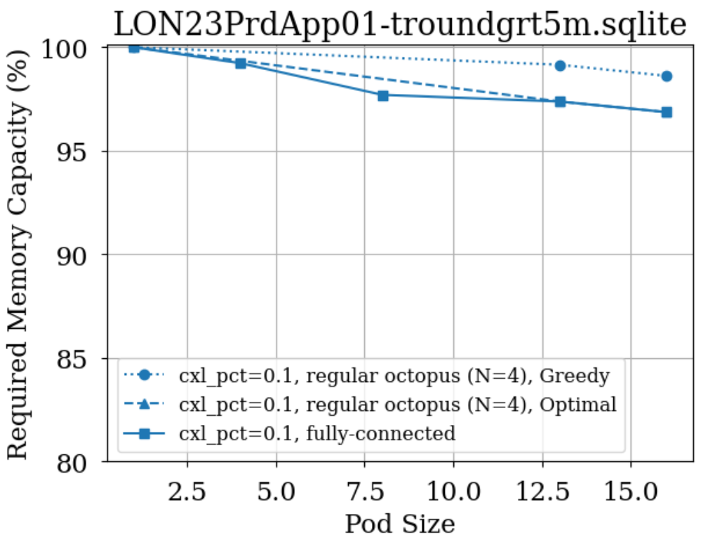
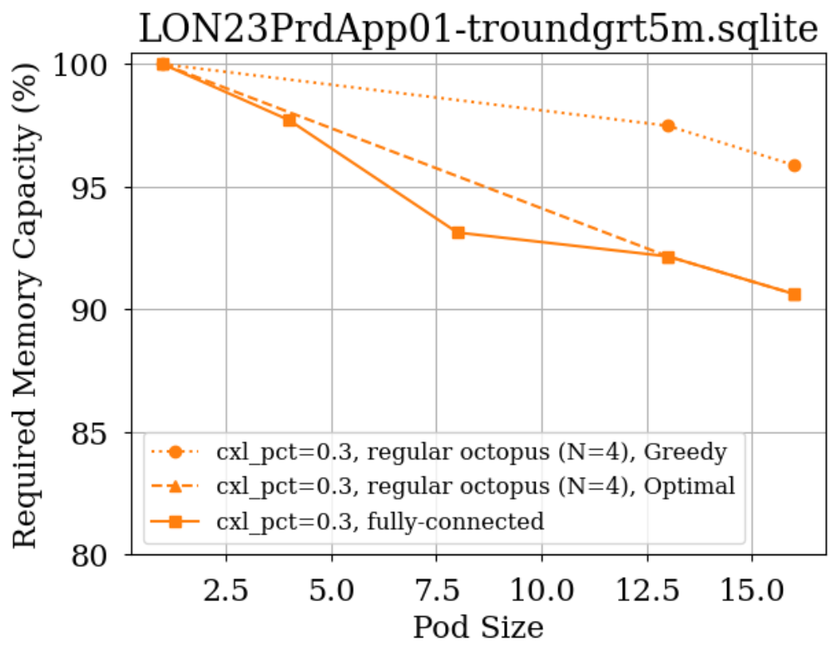
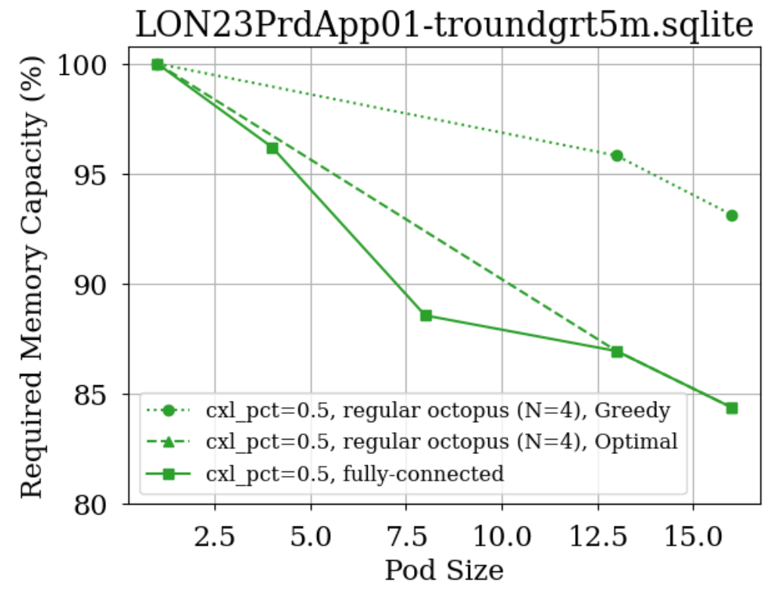
Fully-Connected vs. Octopus (Greedy) vs. Octopus (Optimal)
10% VM Memory in CXL
30% VM Memory in CXL
50% VM Memory in CXL

Slide 10
Fully-Connected vs. Octopus (Greedy) vs. Octopus (Optimal)
50% VM Memory in CXL

Slide 11
Is Migration Necessary?
Perfect balancing likely requires migration
H1 has high memory demand
Later: H3 has high memory demand
🔥
🔥
H1: 10 TB
H1: 5 TB
H2: 1 TB
🔥
🔥
H2: 1 TB
H1: 5 TB
H2: 1 TB
H3: 5 TB
🔥
🔥
H2: 1 TB
H3: 10 TB
H3: 5 TB
H2 has to migrate to P1 to minimize the max MHD usage

Slide 12
Static Optimal Allocation Algorithm
Given future allocations, minimize the peak usages among all MHDs in a pod
Do not allow allocated CXL memory to be moved between MHDs
Can still be modeled as a convex optimization problem, but is more complex and is larger
The scale of the problem is: #MHDs * #VMs

Slide 13
Static Optimal Allocation Algorithm
Approximate the static optimal allocation by splitting the large optimization problem into small intervals:
VM Alloc
VM Alloc
VM Alloc
VM Alloc
VM Stop
VM Alloc
VM Alloc
VM Alloc
VM Stop
VM Alloc
VM Alloc
VM Alloc
Time
run algo (4 hr)
run algo (4 hr)
run algo (4 hr)

Slide 14
Static Optimal Allocation Algorithm
Regular octopus (X=5, N=4, lambda=1):
16 hosts
20 MHDs
Memory savings (50% memory in CXL):
Greedy: 95.0%
(Approximated) Static optimal
4-hour window: 94.5%
8-hour window: 92.3%
Optimal (with reallocation): 88.3%

Slide 15
Different Node-to-Pod Mappings
Regular octopus (X=4, N=4, lambda=1): 13 hosts, 13 MHDs
50% memory in CXL
LON23PrdApp01-troundgrt5m
Required Memory Capacity
 | Mapping 1 | Mapping 2 | Mapping 3 | Mapping 4 | Avg
Greedy | 97.3% | 93.7% | 93.2% | 96.3% | 95.2%
Static Optimal (8-hr window) | 93.9% | 92.4% | 92.2% | 95.1% | 93.4%
Optimal | 91.0% | 89.4% | 88.6% | 88.3% | 89.3%

Slide 16
Greedy allocation, 50% VM memory in CXL, 50 random node-to-pod mapping
matrix_25: 93.8%
25 hosts, 4-port MHDs
matrix_57: 87.3%
57 hosts, 8-port MHDs,
matrix_49: 92.7%
49 hosts, 4-port MHDs

